Slide 1

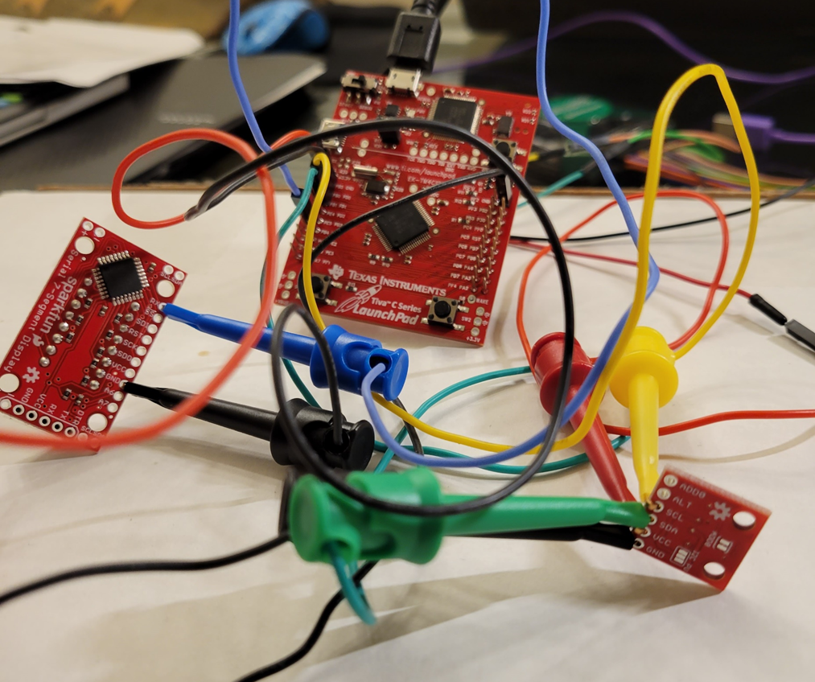
BEE 508 Final Project Design of Temperature Measurement and Display Gwen Montague & Olivia Killingsworth

Slide 2
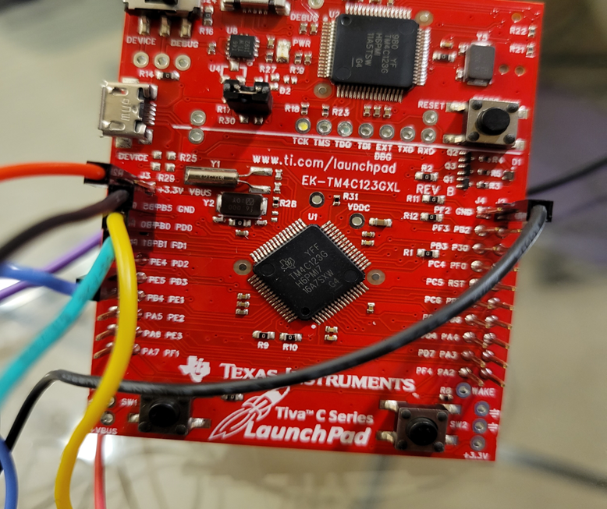
Hardware Assembly
Microcontroller must be able to read data from the sensor and send it to the LED display
Connect the SDA from sensor to PD1 on TIVA (configured as SDA I2C output).
Connect the SCL from sensor to PD0 on TIVA (configured as SCL I2C output).
Connect PE5(TX) on TIVA to receiving RX port on UART LED display
Connect AD2 to TIVA to receive and analyze data from UART and I2C

Slide 3
Programing the Device
Use LEDs on TIVA board to indicate if there is a response from the temperature sensor or not.
Construct 12-bit binary number from the 2 bytes of temperature sensor data
Convert to Celsius value
Convert to a decimal output using modulo and division operators
Send decimal outputs to UART display

Slide 4
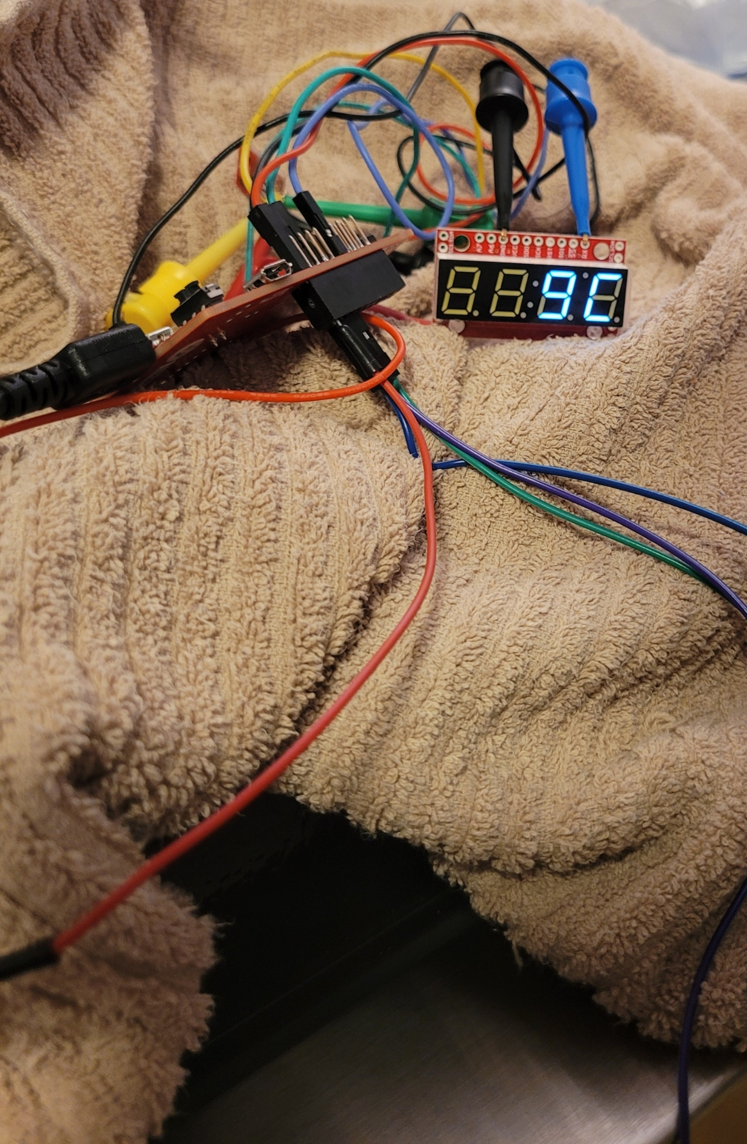
Features: Clearing Leading Zeros
Used nested if else statements to clear leading when decimal value is 2 or 1 digits long
Testing features
Prior to clearing leading zeros ambient room temperature displayed as 022C
After clearing leading zeros ambient room temperature displayed as 22C
Used freezer to test code for clearing leading zero in digit 2 position

Slide 5
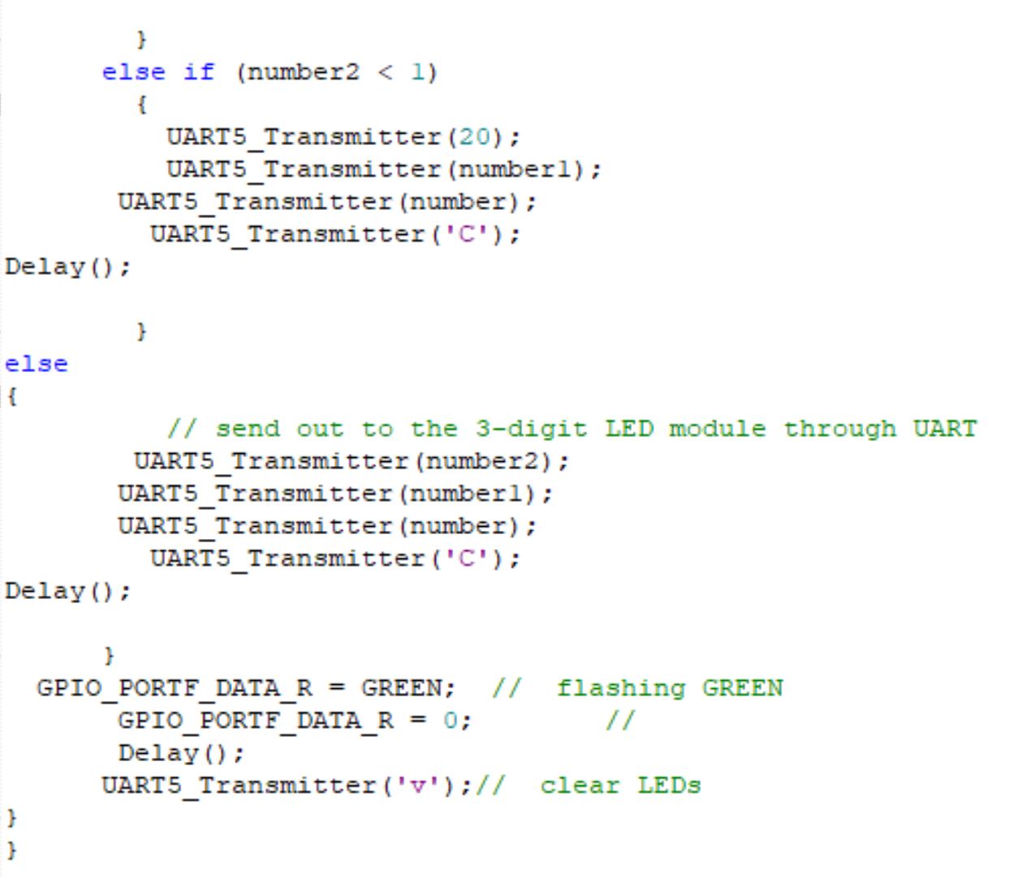
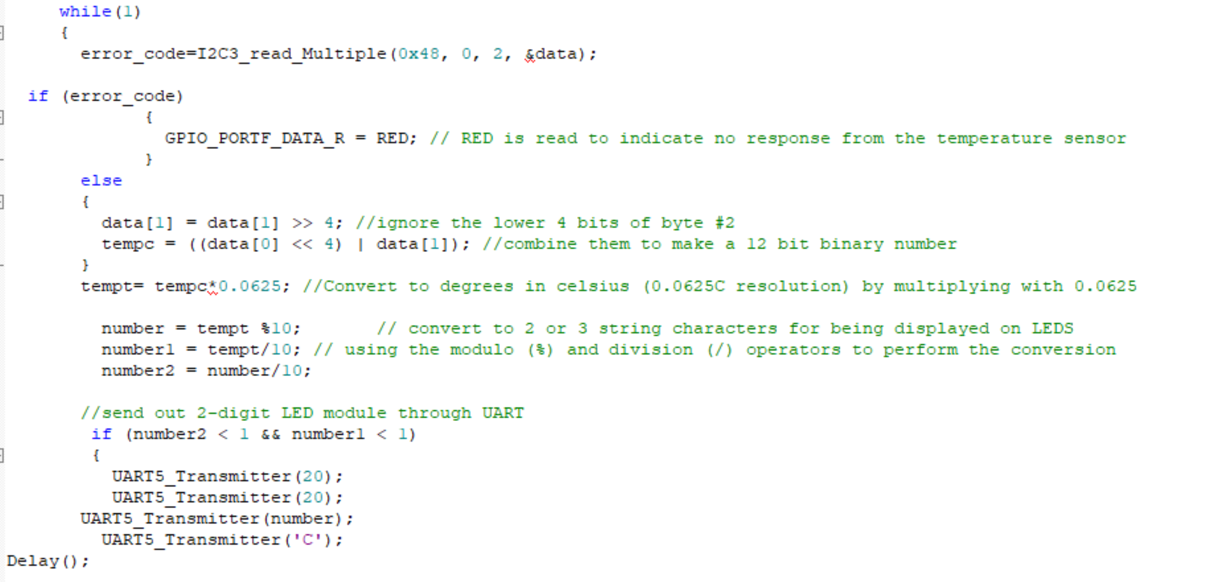
The Code

Slide 6
Testing and Output Data
Analyzed data from AD2
Ambient temperature
Artificially increased temperature using body heat

Slide 7
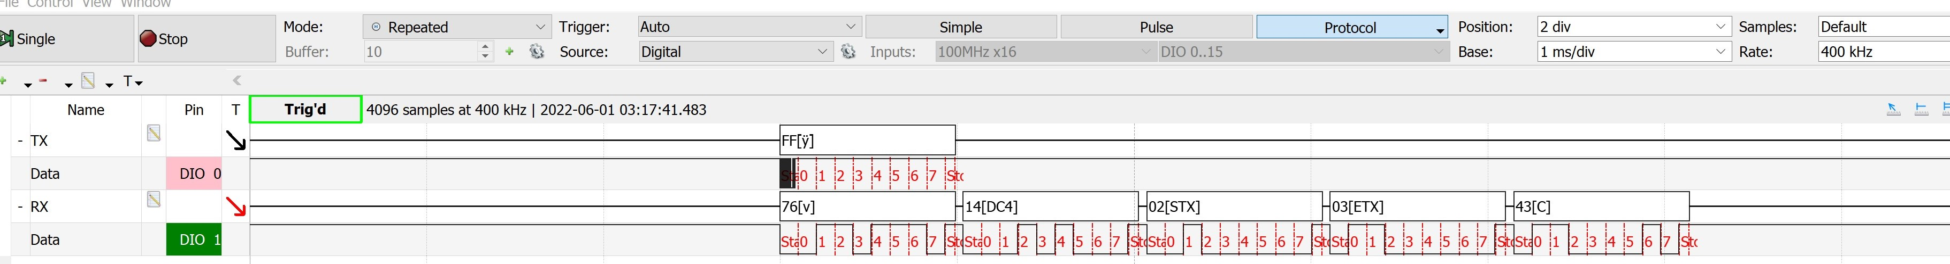
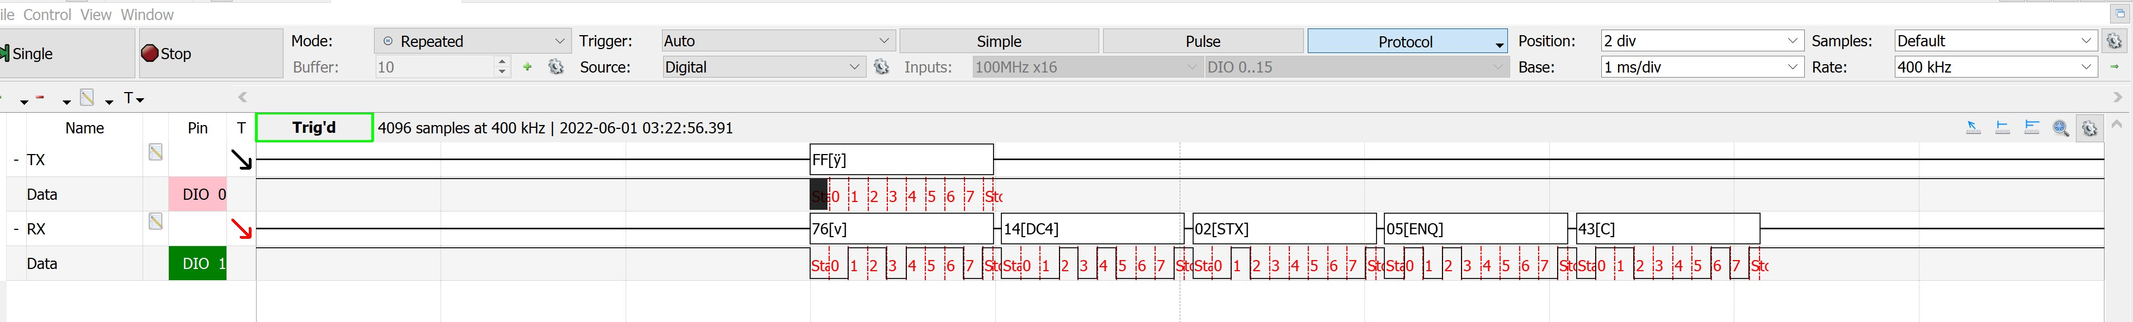
UART Logical Data
Ambient room temp data
Increased temp using finger

Slide 8
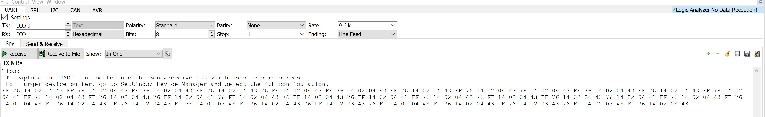
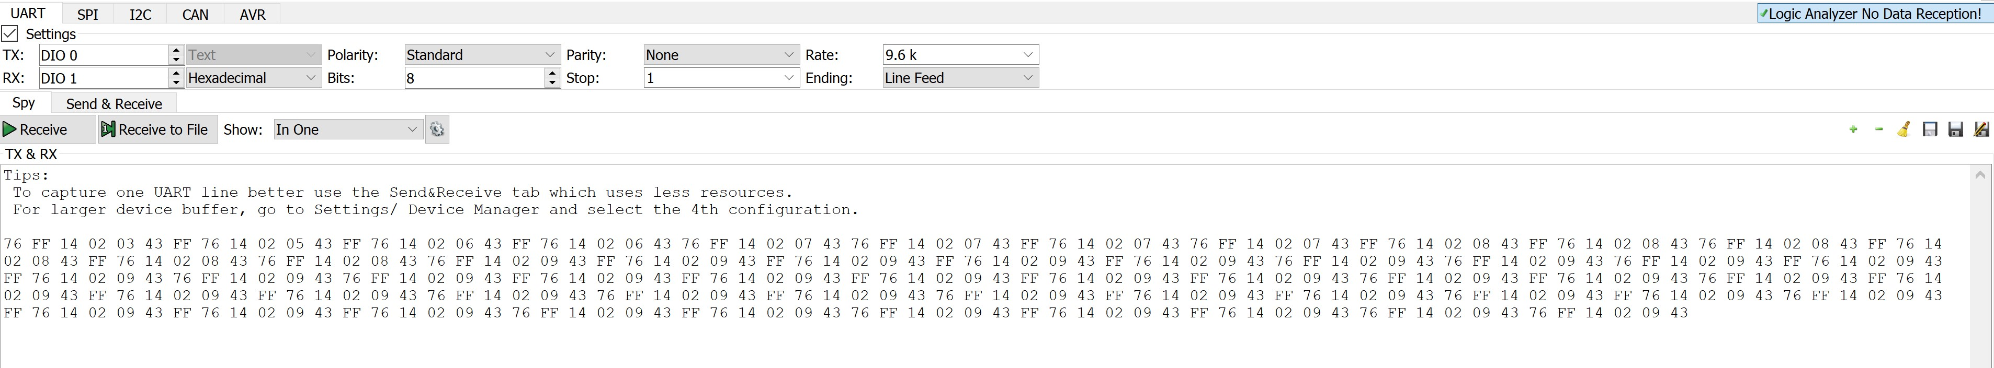


UART Logical Data
Ambient room temp data
Increased temp using finger

Slide 9
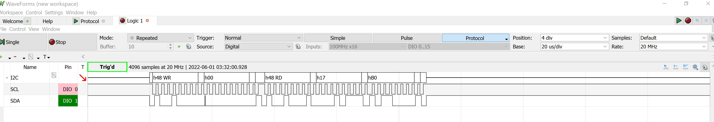
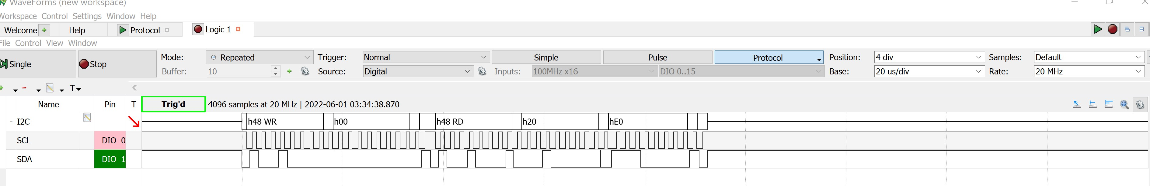
I2C Logical Data
Ambient Room Temp Data
Increased Temp Using Finger

Slide 10
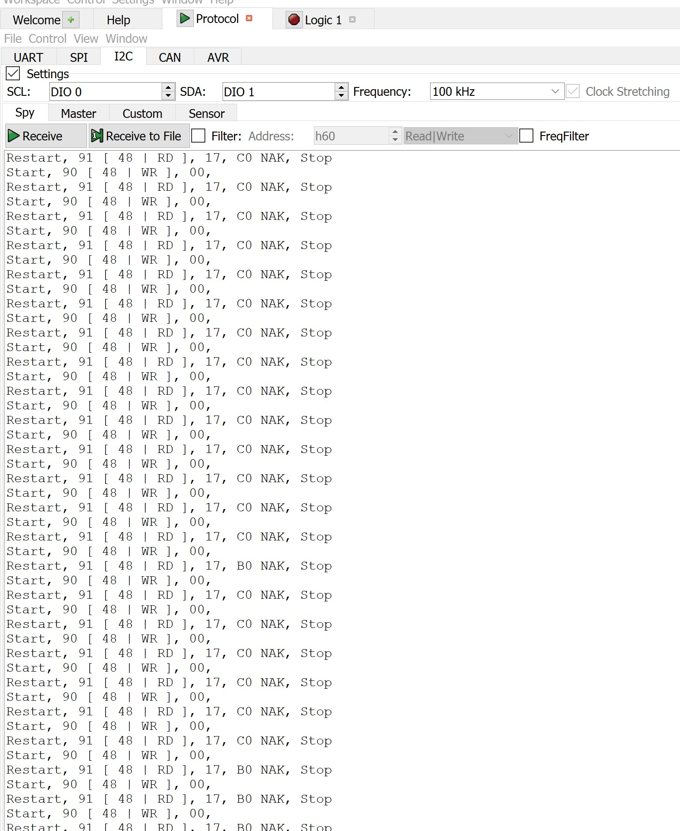
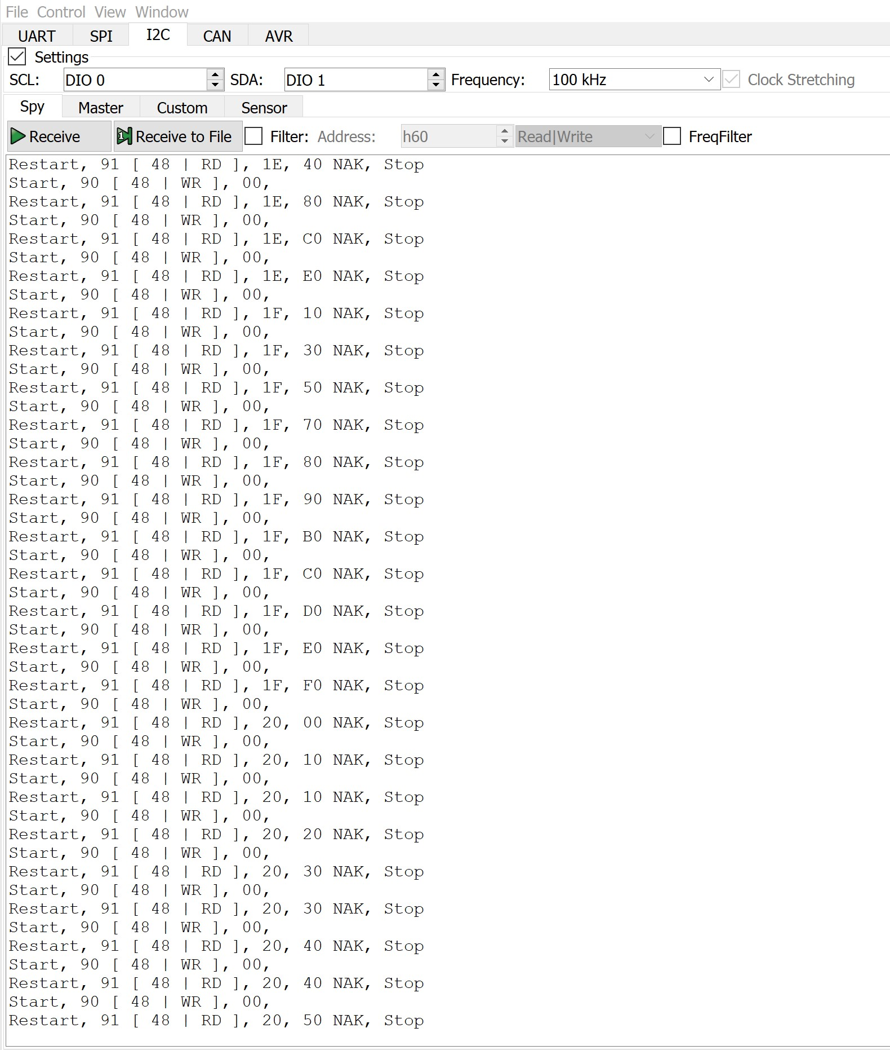

I2C Logical Data
Ambient Room Temp Data
Increased Temp using finger

Slide 11
Demo and Final Questions

